Slide 1
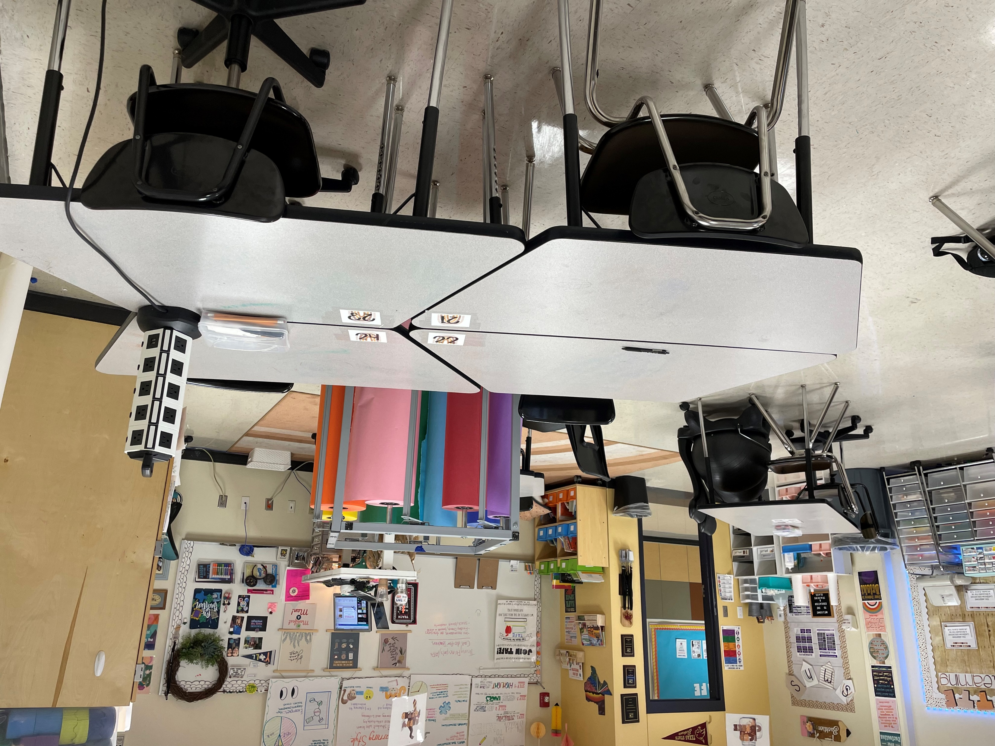
Teaching and Training
Statewide Program of Study
Education and Training Career Cluster
The Education and Training Career Cluster focuses on planning, managing, and providing education and training services and related learning support services. All parts of courses are designed to introduce learners to the various careers available within the Education and Training career cluster.
The Teaching and Training program of study prepares CTE learners for careers related to teaching, instruction, and creation of instructional and enrichment materials. The program of study introduces CTE learners to a wide variety of student groups and their corresponding needs. It familiarizes them with the processes for developing curriculum, coordinating educational content, and coaching groups and individuals.
Work-Based Learning and
Expanded Learning Opportunities
Secondary Courses for High School Credit
1 Principles of Education and Training
2 Human Growth and Development
3 Instructional Practices
4 Practicum in Education and Training
Exploration Activities | Work-Based Learning Activities
Participate in the Texas Association of Future Educators or Family, Career, and Community Leaders of America | Teach a community education class Intern as a teaching assistant or tutor Serve as a camp counselor
Industry-Based Certifications
Educational Aide I
Postsecondary Opportunities
Associates Degrees
Teacher Education
Education, General (or specific subject area)
Special Education
Health and Physical Education/Fitness
Bachelor’s Degrees
Bilingual and Multilingual Education
Education, General (or specific subject area)
Special Education
Health and Physical Education/Fitness
Master’s, Doctoral, and Professional Degrees
Instruction and Learning
Educational Leadership and Administration, General
Special Education
Social and Philosophical Foundations of Education
SMHS Teaching Lab
Aligned Occupations
Occupations | Median Wage | Annual Openings | % Growth
Adult Basic and Secondary Education and Literacy Teachers and Instructors | $48,069 | 862 | 17%
Middle School Teachers, Except Special and Career/Technical Education | $54,510 | 6,407 | 15%
Career and Technical Education Teachers, Secondary School | $56,360 | 719 | 9%
Special Education Teachers, Secondary School | $56,720 | 980 | 18%
Successful completion of the Teaching and Training program of study will fulfill requirements of the Public Service endorsement. Revised – August 2022

Slide 2
Teaching and Training Course Information
COURSE NAME | SERVICE ID | PREREQUISITES | COREQUISITES
Principles of Education and Training | 13014200 (1 credit) 6315 | None | None
Human Growth and Development | 13014300 (1 credit) 6314 | Principles of Ed & Training | None
Instructional Practices | 13014400 (2 credits) 6305 | Human Growth & Development | None
Practicum in Education and Training | 13014500 (2 credits) 6306 | Instructional Practices | None
FOR ADDITIONAL INFORMATION ON THE EDUCATION AND TRAINING CAREER CLUSTER,
PLEASE CONTACT: CJ Odam, SMCISD CTE Coordinator cj.odam@smcisd.net
San Marcos CISD does not discriminate on the basis of race, color, national origin, sex, disability or age in its programs or activities and provides equal access to the Boy Scouts and other designated youth groups. The following person has been designated to handle inquiries regarding the nondiscrimination policies: Stephanie Munoz ; 631 Mill St, San Marcos, TX 78666 ; 512-393-6700 ; stephanie.munoz@smcisd.net
Further nondiscrimination information can be found at smcisd.net/cte

